Slide 1
MATRIX BARCODE BASED DETECTION AND TRACKING FOR AUTONOMOUS UAV LANDING
Mentor : Mr Vivek
Asst. Professor, Electrical and Electronics,
School of Engineering, Amritapuri
Team:
Velayudhan A :AM.EN.U4EEE17101
Nandakishore R Nair : AM.EN.U4EEE17123
Neeraj S :AM.EN.U4EEE17124
Vishnu S :AM.EN.U4EEE17147

Slide 2
INTRODUCTION
The human brain is capable of extracting, processing and manipulating data efficiently as information based on the neural pathways residing over our nervous system with the influence of neurons. However, compared to the machine point of view this concept of identification is relatively harder as they are trained to perform over an algorithm for fast computation. For example, computers can perform large amounts of calculation in milliseconds which would be a lifetime process for human brains. In contrast to that, humans can identify, differentiate, categorise the world around them which is harder from the machine’s perspective. The artificial intelligence concept where the computers think like humans is the near future, but for the computer vision to attain the capability to identify, differentiate, categorise the world, it has to be trained under supervised or unsupervised learning. Image processing with feature extraction is an inevitable part of the machine training process and it is essential to find the most efficient feature extraction algorithm for every possible scenario. The concept of feature extraction works significantly in hand with image processing.

Slide 3
Objective
Creating Halftone AprilTags ✔️
Analogy of point feature extraction techniques ✔️
Landing of UAV

Slide 4
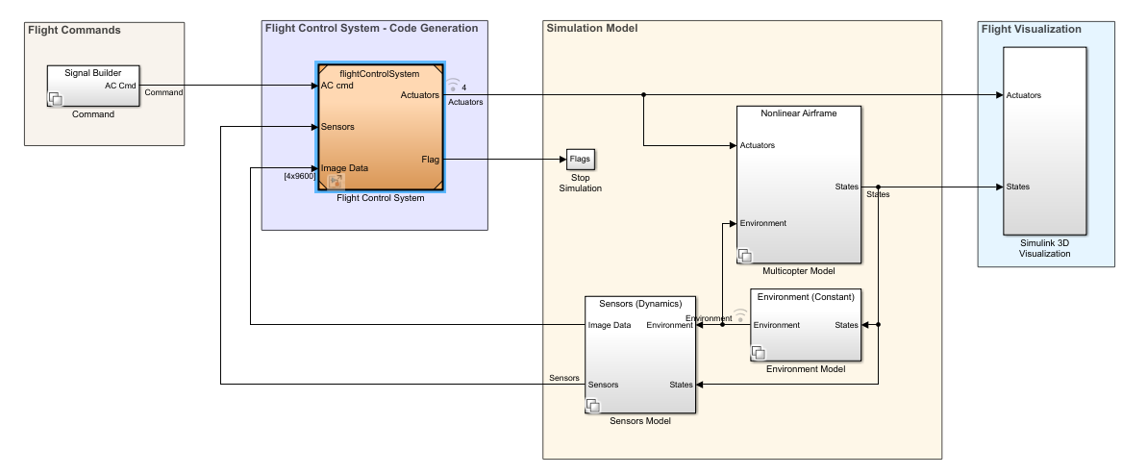
Block Diagram

Slide 5
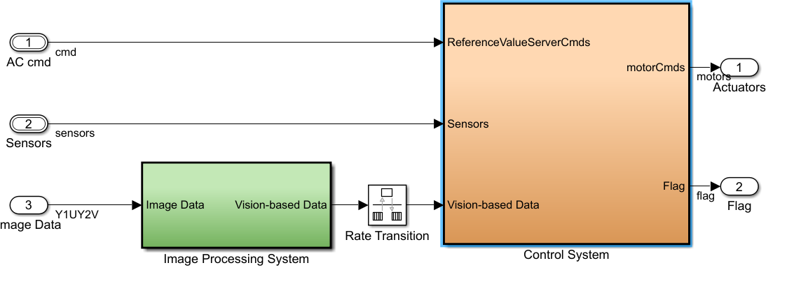
Inside Flight Control System

Slide 6
Phase 1
We have been constantly updating the project prerequisites and learning the ways by which this task of autonomous uav landing using fiducial markers can be implemented. As a result we have enrolled ourselves in various courses offered by various online platforms such as edX so that the basics is strong.
Also as the trend of robotic systems is prevalent in the vast sector, proper simulation and documentation needs to be facilitated as a result the totally new concept of ROS is been focal point. We have made ways to educate ourselves with this meta operating software.
MATlab implementation of the feature extraction is been understood as it is been used in the existing packages prevalent in the UAV techs. Also the codes for the drone fight and general navigation is been exported.
Simulations and codes in phase 1
Basic feature extraction in MATLAB using SURF method
Drone maneuvering simulation
PWM generation for the ESC module from input commands

Slide 7
WORK DONE THIS SEMESTER
An experiment was conducted for the cross comparison of the various available feature extraction algorithm namely,
BRISK
FAST
HARRIS
KAZE
MINEIGEN
MSER
ORB
SURF
The parameters considered for the cross comparison were Time taken for feature extraction and number of match points detected and the test was conducted by introducing effects and distortions like rotation, scale change and noise.

Slide 8
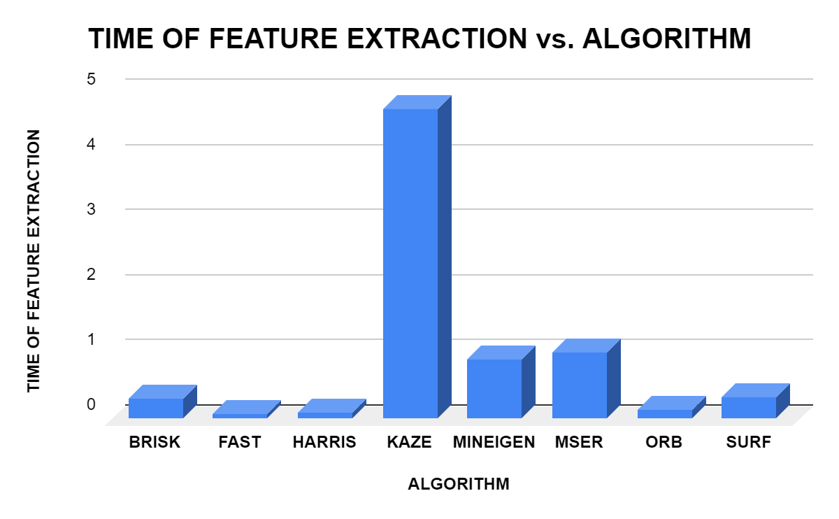
Time of feature extraction
This section tabulates the time required for feature extraction of each point feature extraction methods namely BRISK, FAST, HARRIS, KAZE, MINEIGEN, MSER, ORB, SURF.
ALGORITHM | TIME OF FEATURE EXTRACTION
BRISK | 0.313587
FAST | 0.074147
HARRIS | 0.0853465
KAZE | 4.763558
MINEIGEN | 0.91857
MSER | 1.010411
ORB | 0.148321
SURF | 0.334866

Slide 9
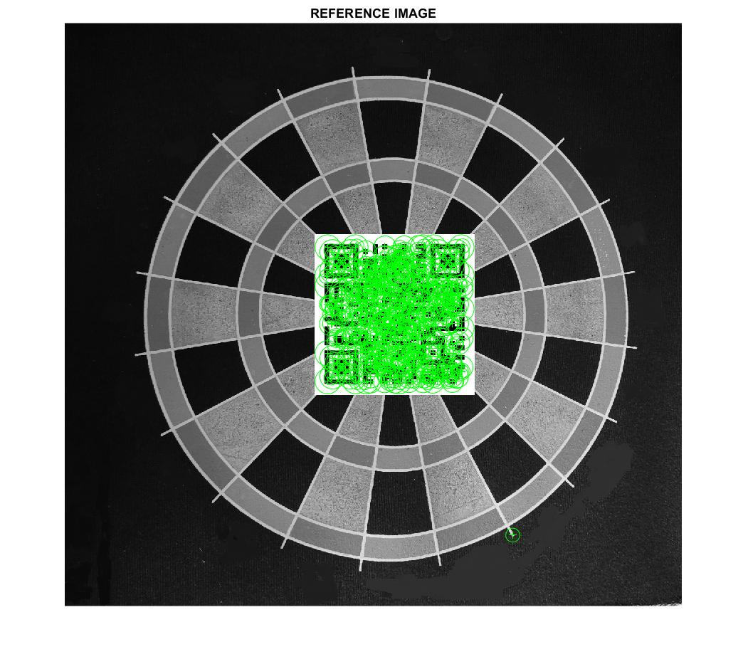
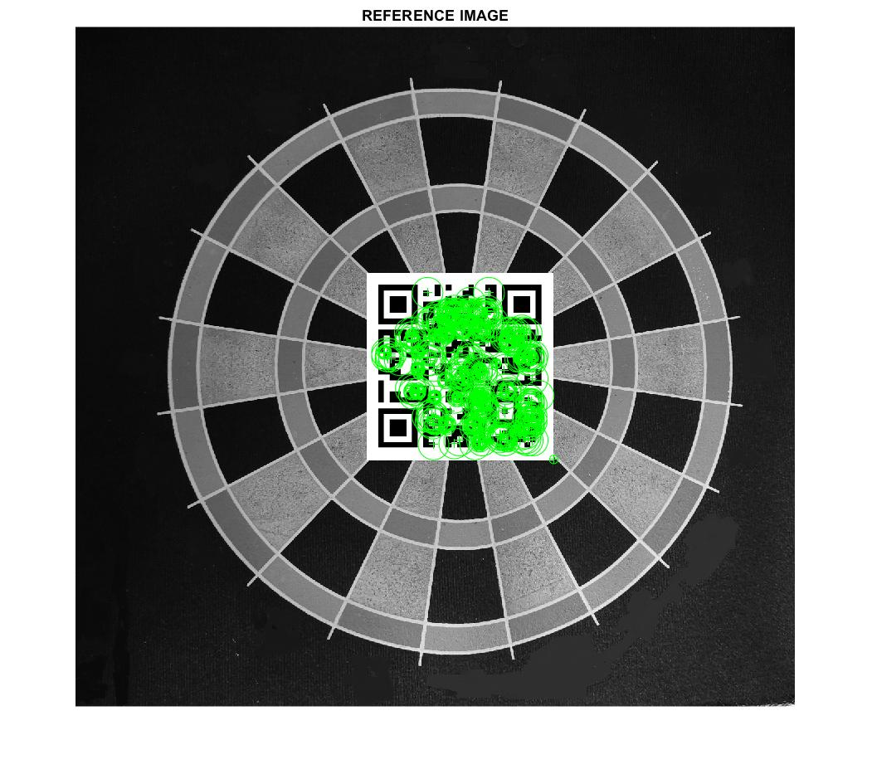
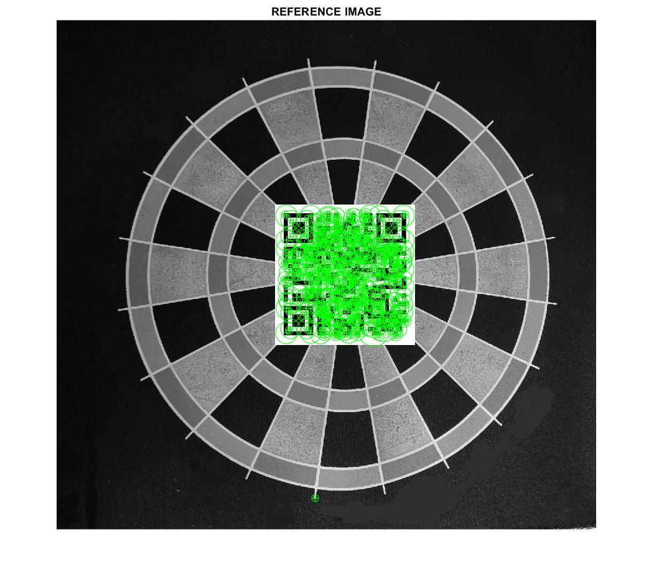
Extracted feature points using different methods
Feature extraction using KAZE method
Feature extraction using ORB method
Feature extraction using SURF method

Slide 10
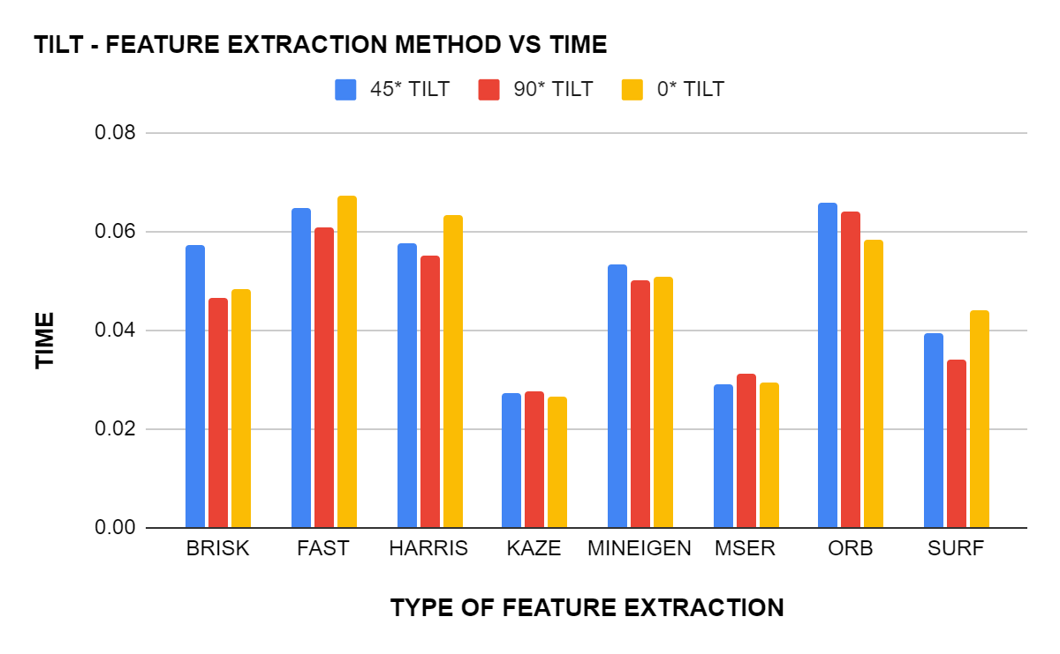
TILT - FEATURE EXTRACTION METHOD VS TIME
TILT - FEATURE EXTRACTION METHOD VS TIME
ALGORITHM/TILT ANGLE | 45* TILT | 90* TILT | 0* TILT
BRISK | 0.057429 | 0.046397 | 0.048213
FAST | 0.064922 | 0.060837 | 0.067189
HARRIS | 0.057784 | 0.055006 | 0.063457
KAZE | 0.02712 | 0.027696 | 0.026556
MINEIGEN | 0.053279 | 0.050198 | 0.05072
MSER | 0.029002 | 0.031249 | 0.029311
ORB | 0.06573 | 0.064043 | 0.05838
SURF | 0.039339 | 0.03423 | 0.044163

Slide 11
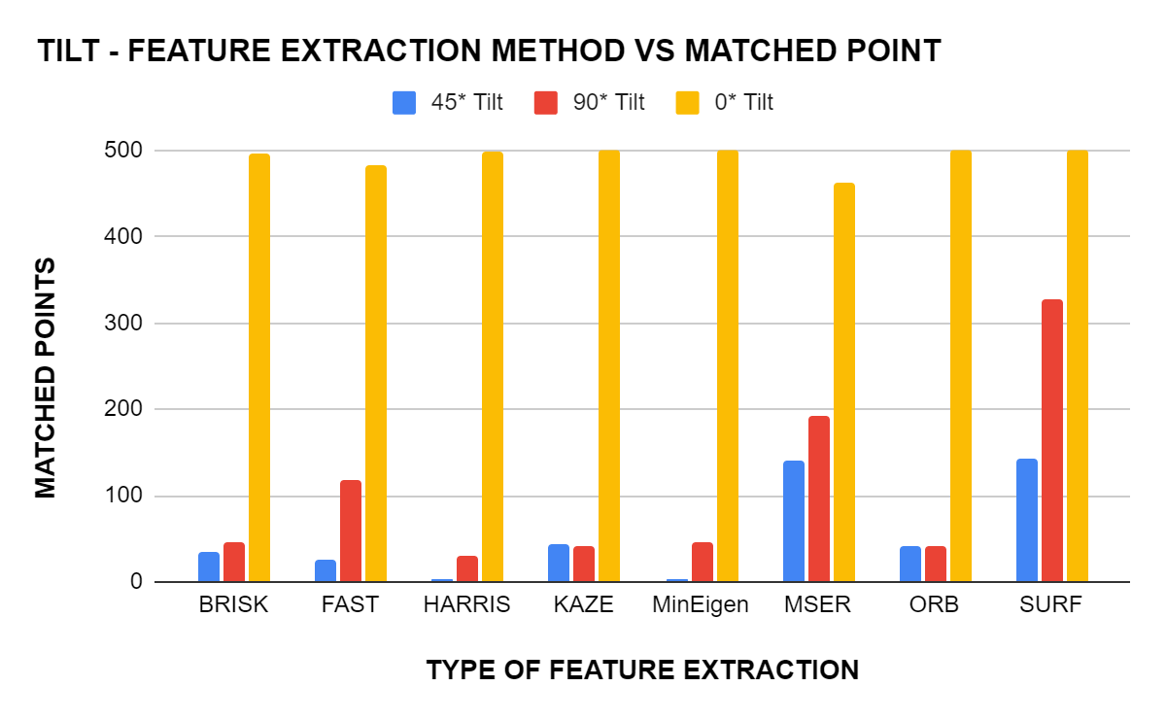
TILT - FEATURE EXTRACTION METHOD VS MATCHED POINT
TILT - FEATURE EXTRACTION METHOD VS MATCHED POINT
Algorithm | 45* Tilt | 90* Tilt | 0* Tilt
BRISK | 35 | 47 | 496
FAST | 25 | 118 | 483
HARRIS | 3 | 31 | 498
KAZE | 44 | 41 | 500
MinEigen | 3 | 46 | 500
MSER | 140 | 193 | 463
ORB | 41 | 41 | 500
SURF | 142 | 327 | 500

Slide 12
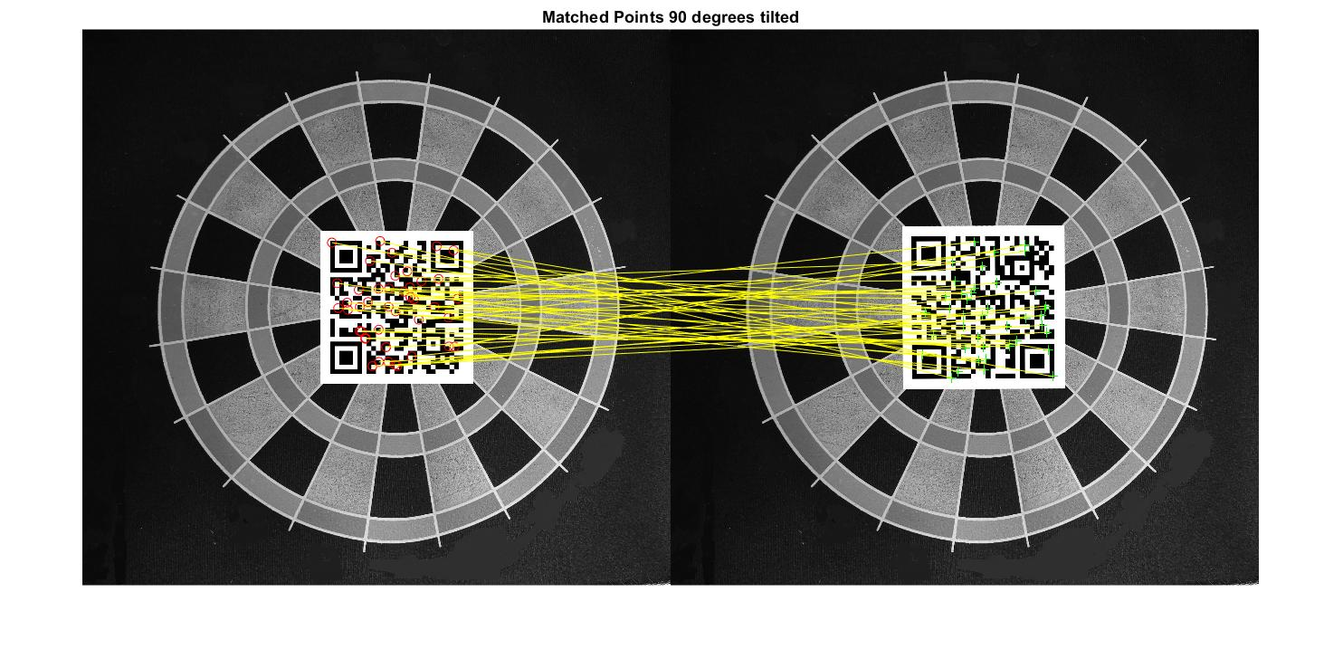
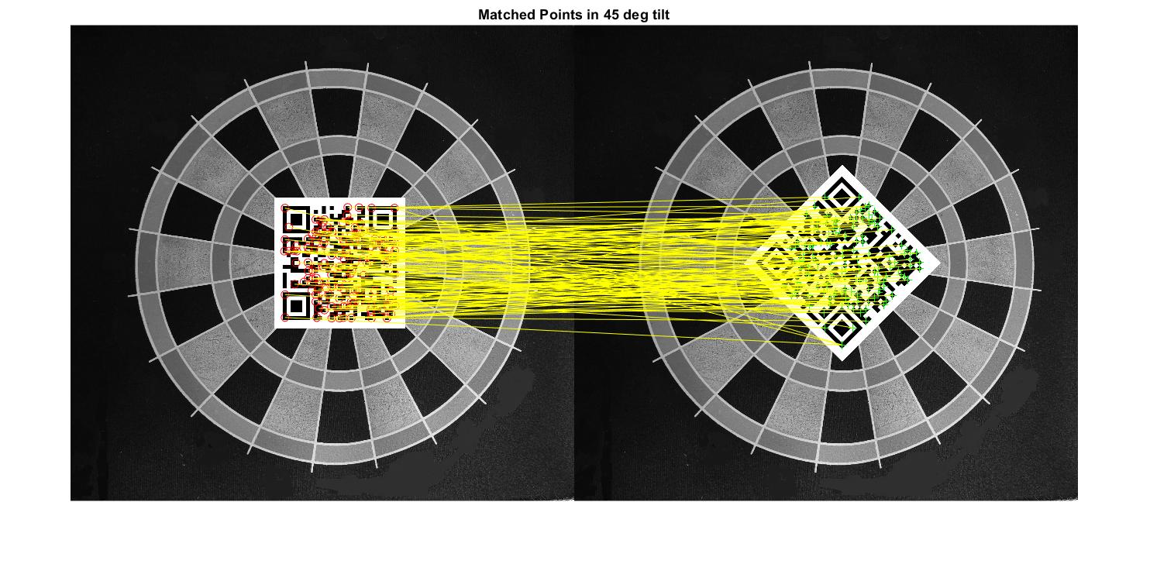
Feature point cross matching using BRISK method at a tilt of 90 degree
Feature point cross matching using SURF method at a tilt of 45 degree

Slide 13
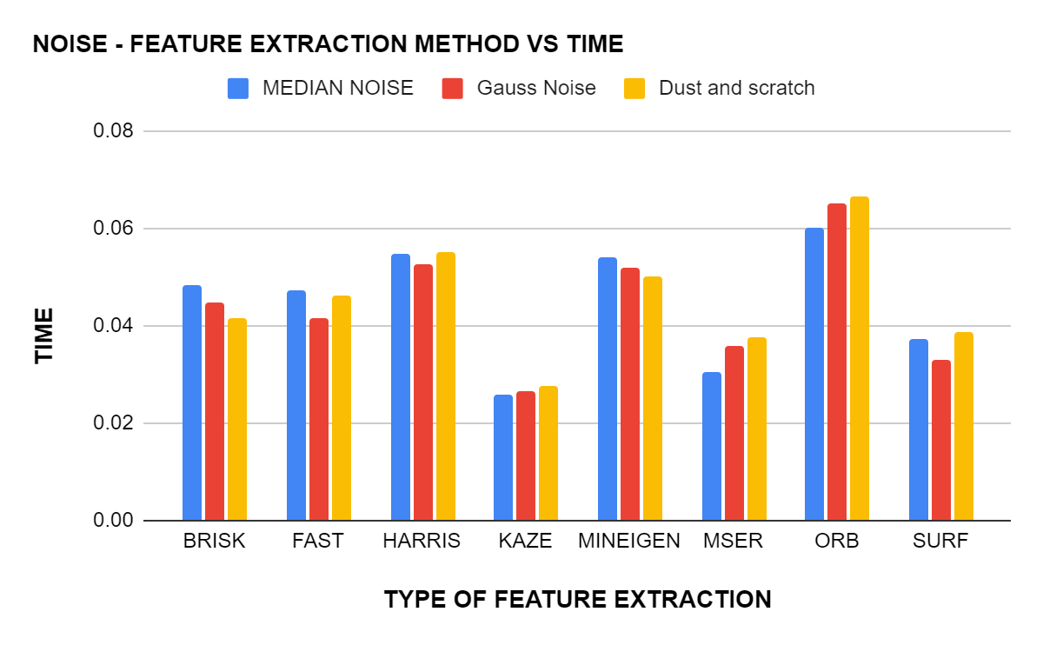
NOISE - FEATURE EXTRACTION METHOD VS TIME
NOISE - FEATURE EXTRACTION METHOD VS TIME
ALGORITHM | MEDIAN NOISE | Gauss Noise | Dust and scratch
BRISK | 0.048426 | 0.044872 | 0.041388
FAST | 0.047351 | 0.041478 | 0.04614
HARRIS | 0.054686 | 0.05249 | 0.05528
KAZE | 0.025917 | 0.026505 | 0.027484
MINEIGEN | 0.054124 | 0.051961 | 0.050279
MSER | 0.030573 | 0.035674 | 0.037759
ORB | 0.060046 | 0.065243 | 0.066454
SURF | 0.037223 | 0.033108 | 0.038761

Slide 14
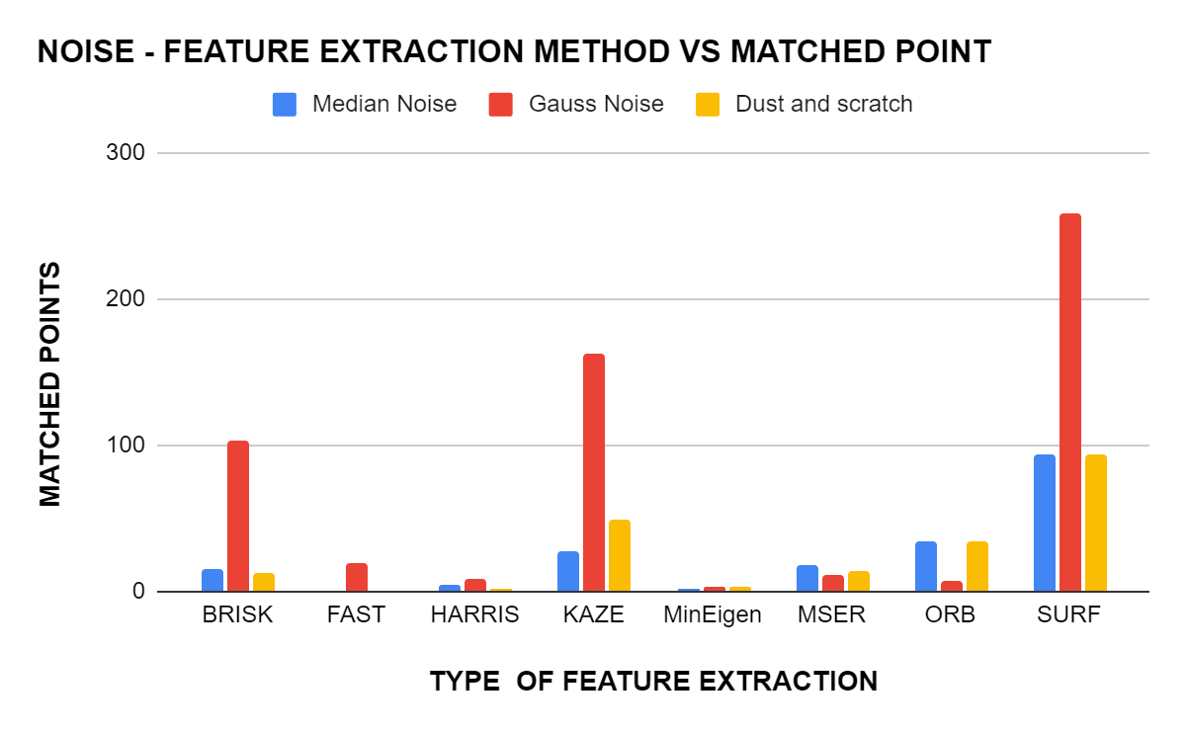
NOISE - FEATURE EXTRACTION METHOD VS MATCHED POINT
NOISE - FEATURE EXTRACTION METHOD VS MATCHED POINT
Algorithm | Median Noise | Gauss Noise | Dust and scratch
BRISK | 15 | 103 | 13
FAST | 0 | 20 | 1
HARRIS | 4 | 9 | 2
KAZE | 28 | 162 | 49
MinEigen | 2 | 3 | 3
MSER | 18 | 12 | 14
ORB | 34 | 8 | 34
SURF | 94 | 259 | 94

Slide 15
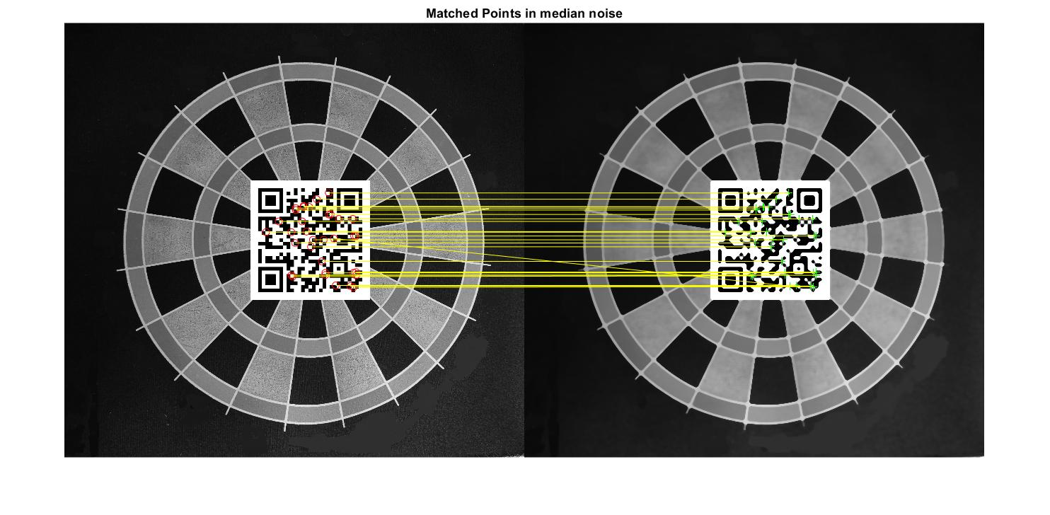
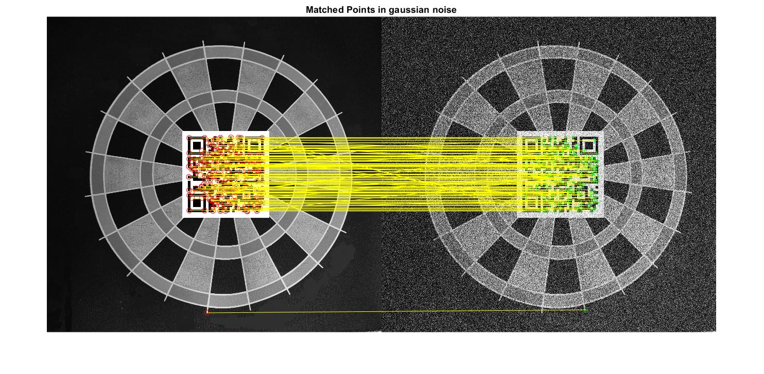
Feature point cross matching using ORB method for median noise
Feature point cross matching using SURF method for gaussian noise

Slide 16
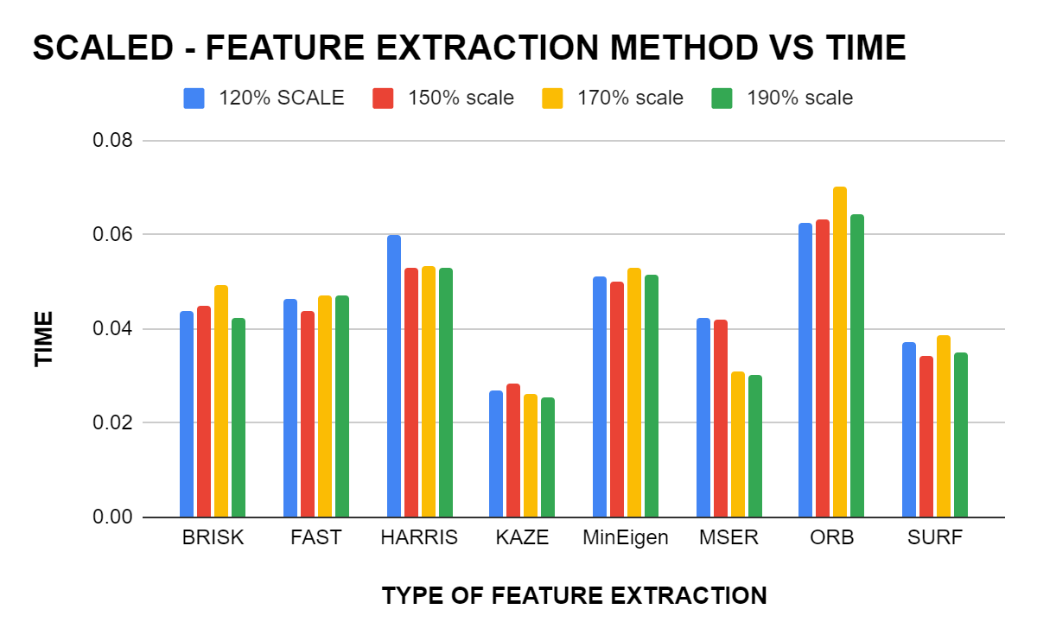
SCALED - FEATURE EXTRACTION METHOD VS TIME
SCALED - FEATURE EXTRACTION METHOD VS TIME
ALGORITHM/SCALED FACTOR | 120% SCALE | 150% scale | 170% scale | 190% scale
BRISK | 0.0439 | 0.04487 | 0.049317 | 0.042299
FAST | 0.046347 | 0.043665 | 0.047194 | 0.047015
HARRIS | 0.059786 | 0.052826 | 0.053238 | 0.053117
KAZE | 0.026761 | 0.028547 | 0.026327 | 0.025562
MinEigen | 0.051124 | 0.049958 | 0.052885 | 0.051355
MSER | 0.042234 | 0.041882 | 0.030799 | 0.030086
ORB | 0.062399 | 0.063155 | 0.070053 | 0.064498
SURF | 0.037279 | 0.034314 | 0.038728 | 0.035153

Slide 17
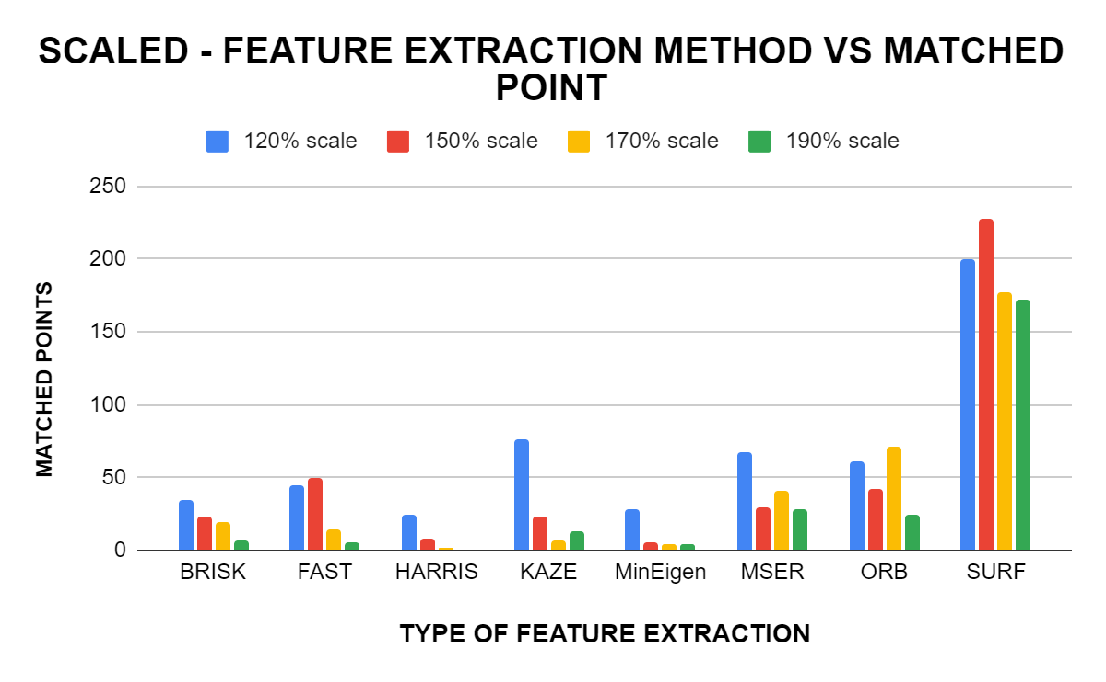
SCALED - FEATURE EXTRACTION METHOD VS MATCHED POINT
SCALED - FEATURE EXTRACTION METHOD VS MATCHED POINT
Algorithm | 120% scale | 150% scale | 170% scale | 190% scale
BRISK | 35 | 23 | 19 | 7
FAST | 45 | 50 | 14 | 6
HARRIS | 25 | 8 | 2 | 0
KAZE | 76 | 23 | 7 | 13
MinEigen | 28 | 5 | 4 | 4
MSER | 67 | 29 | 41 | 28
ORB | 61 | 42 | 71 | 25
SURF | 200 | 228 | 177 | 172

Slide 18
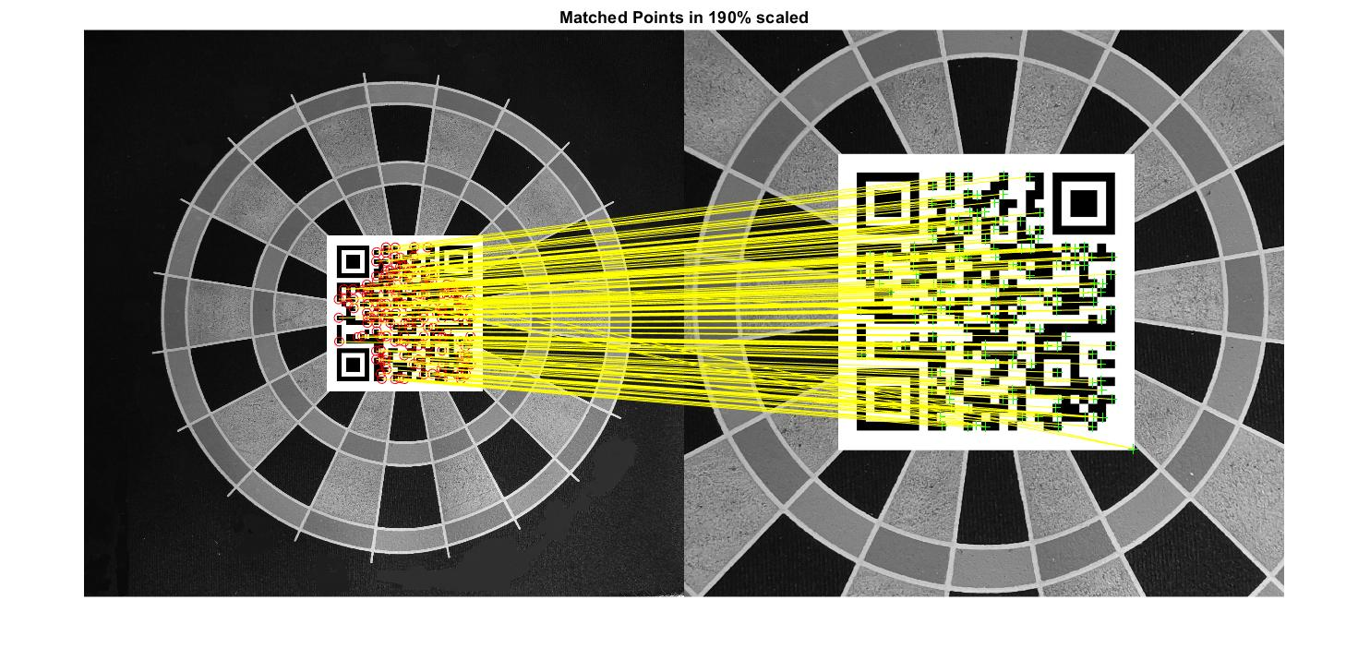
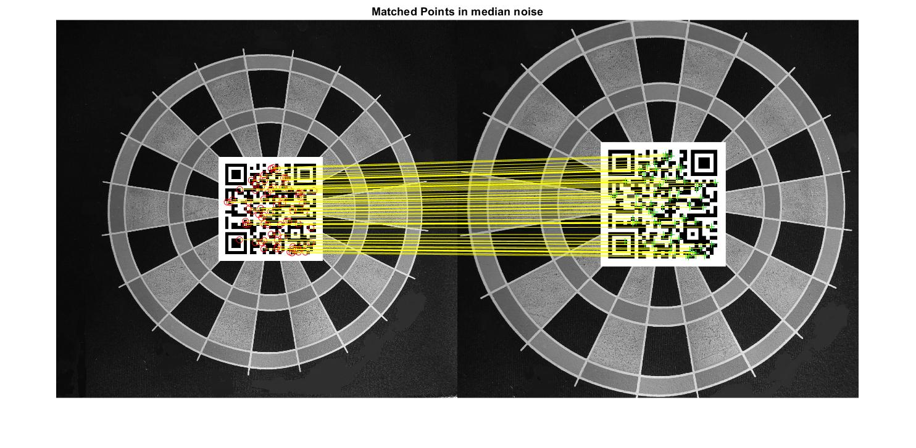
Feature point cross matching using SURF method at a scale of 190%
Feature point cross matching using KAZE method at a scale of 120%

Slide 19
Inference from the data
From the above data and graphs it can be concluded that ,the SURF algorithm performs the best in cases of noise, rotation and scaling with maximum feature points extracted in a relatively minimal time. Brisk is the method that performed moderately well in all of the test scenarios. FAST has the least time for feature extraction and KAZE has the most time among them. ORB performs well in scaled case but at the cost of time.
In the case of noise and scaled condition, SURF outperforms every other method with the highest number of feature points matched with the best time to points matched ratio. Even though KAZE has the least time taken, the number of points matched is way less.
In the case rotation, SURF and MSER performs the best among them with a maximum number of extracted points matched in a relatively less time frame. All the features matched all the points when presented with ZERO degrees tilt.
Therefore,it can be concluded from the above data that SURF feature extraction method is the optimum method for the application in our project.

Slide 20
Code to Generate AprilTag
import numpy as np
from collections import namedtuple
from .tags import tag16h5
from .tags import tag25h9
from .tags import tag36h10
from .tags import tag36h11
flip = lambda a: a^1
Tag = namedtuple("Tag", "family id array")
apriltags = {
"tag16h5": tag16h5,
"tag25h9": tag25h9,
"tag36h10": tag36h10,
"tag36h11": tag36h11
}
def gen_tag(tag, val):
d = np.frombuffer(np.array(tag.codes[val], ">i8"), np.uint8)
bits = np.unpackbits(d)[-tag.area:].reshape((-1,tag.dim))
bits = np.pad(bits, 1, 'constant', constant_values=0)
return bits
def generate(family, nums):
tagdata = apriltags[family]
except:
print(f"*** Invalid family: {family} ***")
exit(1)
tags = [Tag(family, n, gen_tag(tagdata, n)) for n in nums]
return tags
def check_size(r, size):
if r >= size:
raise Exception(f"family board size exceeded: {r} != {size}")
def board(marker_size, family, scale=10, ofw=2, span=None):
if span:
r = span
if len(span) !=

Slide 21
r = marker_size[0]*(ofr)
c = marker_size[1]*(ofc)
b = np.ones((r,c))
box = np.zeros((ofw,ofw))
for i in range(marker_size[0]): # rows
for j in range(marker_size[1]): # cols
r = i*(ofr)
c = j*(ofc)
x = i*marker_size[1]+j
tag = tags[x].array
b[r:r+tag_size,c:c+tag_size] = tag
r,c = b.shape
mm = np.ones((r+ofw, c+ofw), dtype=np.uint8)
mm[ofw:,ofw:] = b
for i in range(marker_size[0]+1): # rows
for j in range(marker_size[1]+1): # cols
r = i*(ofr)
c = j*(ofc)
mm[r:r+ofw,c:c+ofw] = box
mm = 255*mm
xx = np.repeat(np.repeat(mm, scale, axis=0), scale, axis=1)
return xx
marker_size[0]*marker_size[1]:
raise Exception("Span doesn't fit inside marker_size; len(span) != marker_size[0]*marker_size[1]")
else:
r = marker_size[0]*marker_size[1]
if family == "tag36h10":
check_size(r, len(tag36h10.codes))
tag_size = 8
elif family == "tag36h11":
check_size(r, len(tag36h11.codes))
tag_size = 8
elif family == "tag25h9":
check_size(r, len(tag25h9.codes))
tag_size = 7
elif family == "tag16h5":
check_size(r, len(tag16h5.codes))
tag_size = 6
else:
raise Exception(f"Invalid tag family: {family}")
tags = generate(family, range(r))
ofr = tag_size+ofw
ofc = tag_size+ofw

Slide 22
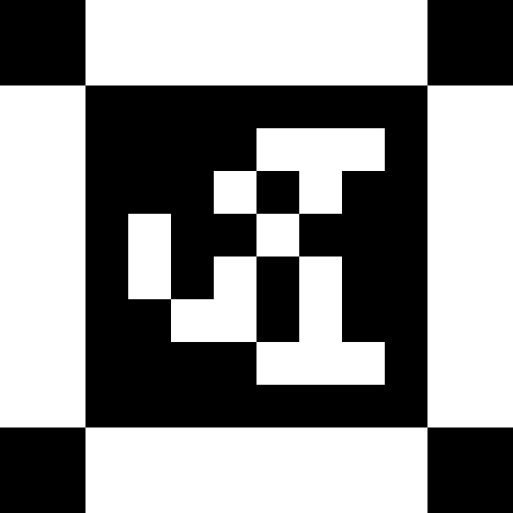
import moms_apriltag as apt
import numpy as np
import imageio
if __name__ == '__main__':
family = "tag36h10"
shape = (1,1)
filename = input("enter filename")
filename=filename+".png"
size = 50
tgt = apt.board(shape, family, size)
imageio.imwrite(filename, tgt)
print("image saved ")
Example of generated AprilTag

Slide 23
Time Plan
December 2020 | Controlling the motor output with respect to the given movement commands.
January 2021 | April tag Generation and comparison of point feature extraction technique
February 2021 | Analogy of point feature extraction technique
March 2021 | Environment modeling in MATLAB.
April 2021 | Autonomous Landing

Slide 24
Conclusion
From the experiments conducted based on various factors of distortion in images for the feature extraction techniques available, we concluded that SURF has the highest efficacy with respect to other available feature extraction algorithms.

Slide 25
Reference
BRISK: Binary Robust Invariant Scalable Keypoints Stefan Leutenegger, Margarita Chilli and Roland Y. Siegwart Autonomous Systems Lab, ETH Zurich
Leutenegger, Stefan, M.Chli, and R.Siegwart(2011), “BRISK: Binary robust invariant scalable keypoints.”, In Proceedings of “IEEE International Conference on Computer Vision (ICCV)”, pp. 2548-2555.
Wu, M. Research on optimization of image fast feature point matching algorithm. J Image Video Proc. 2018, 106 (2018). https://doi.org/10.1186/s13640-018-0354-y
Zeng, Yonghong & Liang, Ying-Chang. (2007). Maximum-Minimum Eigenvalue Detection for Cognitive Radio. 1 - 5. 10.1109/PIMRC.2007.4394211.
P.-E. Forssen(2007), “Maximally stable colour regions for recognition and matching,” In Proceedings of “IEEE Conference on Computer Vision and Pattern Recognition”, Minneapolis, USA.
Donoser, Michael & Bischof, Horst. (2006). Efficient Maximally Stable Extremal Region (MSER) Tracking.IEEE Comp. Soc. Conf. Comp. Vis. Pattern Recogn. 1.553-560.10.1109/CVPR.2006.107.
ORB: an efficient alternative to SIFT or SURF, Ethan Rublee Vincent Rabaud Kurt Konolige Gary Bradski

Slide 26
Speeded-Up Robust Feature Extraction and Matching for Fingerprint Recognition, Umma Hany; Lutfa Akter; 2nd Int'l Conf. on Electrical Engineering and Information & Communication Technology (ICEEICT) 2015 Jahangirnagar University, Dhaka-1342, Bangladesh, 21-23 May 2015
H. Bay, A. Ess, T. Tuytelaars, L. Van Gool(2008), “SURF: Speeded Up Robust Features, “Computer Vision and Image Understanding, vol. 110(3), pp. 346–359.
Harris and M. Stephens (1988), “A combined corner and edge detector”, (PDF), In: Proceedings of Alvey Vision Conference, pp. 147–151.
Evaluating Harris Method in Camera Calibration OUYANG Cheng, WANG Guangzhi, ZHANG Quan, KANG Wei, DING Hui, Proceedings of the 2005 IEEE Engineering in Medicine and Biology 27th Annual Conference Shanghai, China, September 1-4, 2005
Kok, Kai Yit & Rajendran, Parvathy. (2018). Validation of Harris Detector and Eigen Features Detector. IOP Conference Series Materials Science and Engineering. 370. 10.1088/1757-899X/370/1/012013.
Alcantarilla P.F., Bartoli A., Davison A.J. (2012) KAZE Features. In: Fitzgibbon A., Lazebnik S., Perona P., Sato Y., Schmid C. (eds) Computer Vision – ECCV 2012. ECCV 2012. Lecture Notes in Computer Science, vol 7577. Springer, Berlin, Heidelberg. https://doi.org/10.1007/978-3-642-33783-3_16
Comparison and Study of Classic Feature Point Detection Algorithm Daguang Jiang, Junkai Yi 2012 International Conference on Computer Science and Service System
Performance Evaluation of Various Feature detection Algorithms in VSLAM, S.SriVidhya, Prakash S, ISSN - 2250-1991 | IF 5.215 | IC Value: 79.96, PARIPEX - INDIAN JOURNAL OF RESEARCH
J. Bauer, H. Bischof, A. Klaus, K. Karner(2004), “Robust and fully automated image registration using invariant features,” ISPRS, DVD Proc, pp. 12–23.

